Slide 1

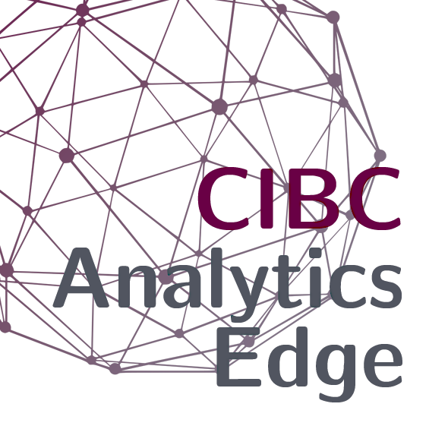
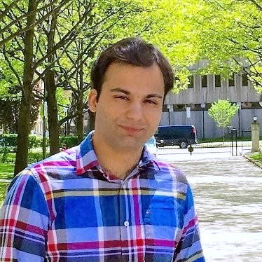
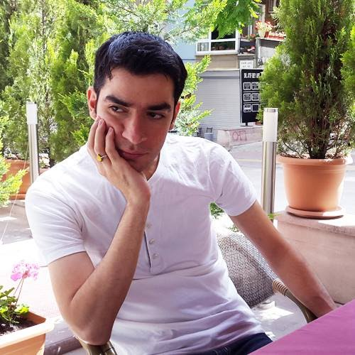

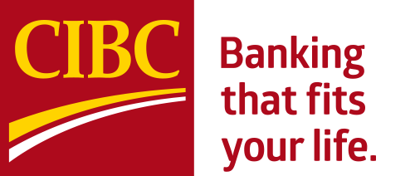
Introduction to Data Shift and Concept Drift
Data Shift is a phenomenon where the underlying distribution of data changes, and it may subsequently lead to undesired consequences. For example, an ML model may become outdated within an (unknown) period due to an (unexpected) event, e.g., COVID 19, and it won’t present a promising result anymore. Data shift may appear in different forms of covariate shift, label shift, and concept shift leading to more challenges. No doubt, it is necessary to detect data shifts and adapt our ML models accordingly. During the talk, Mehdi Ataei and Ali Pesaranghader explain fundamental concepts of data shift and present a roadmap to react to data shift appropriately.
26 March 2021
Session 7
Mehdi Ataei, Ph.D. Candidate – Vector Institute
Mehdi is a Graduate Researcher and Postgraduate Affiliate at the Vector Institute. He will defend his Ph.D. in Computational Mechanics at the University of Toronto in Winter 2021. During his studies, he published several research papers and a patent related to physics-based machine learning (in prestigious publications such as AAAI and Computer Physics Communications) and released several open-source software for computational modelling of multiphysics problems. Mehdi is also CTO of Examify – an e-learning platform helping instructors administer technical exams that is currently in use by Ontario institutions.
Ali Pesaranghader, Ph.D. – CIBC Data Science & AI Research
Ali is a Sr. Research Scientist on the Data Science and AI Research team at CIBC
and he collaborates on NLP-related projects, e.g., NPS and verbatim analysis.
Prior to joining CIBC in May 2019, he finished his Ph.D. in Computer Science
and Adaptive Machine Learning at the University of Ottawa. Ali holds a great
record of research papers in well-known venues, including, Machine Learning
Journal, Journal of the American Medical Informatics Association (JAMIA),
European Conference on Machine Learning (ECML) amongst others. Besides AI and ML, Ali is interested in Art, Geometry, and Sociology.

